Slide 1
Lab 2: minimizers
DUE Friday September 19 at 8:00pm
CODE (100% undergrad, 80% grad): Write three python functions to compute minimizers for a genomic sequence:
reverse_complement(seq): returns reverse complement of a sequence seq
compute_num_value(seq): returns numerical value of sequence seq (A=0,C=1,G=2,T=3), base 4 starting with the first letter
For each k-mer compute numerical value forward and reverse, use minimum
compute_minimizers(seq,k,w): computes minimizers for sequence seq, k-mer k, and window w, returns an array containing 0-based leftmost position of each minimizer
Submit code through autograder, name code minimizers.py
FIGURE (20% graduate students ONLY):
Generate random sequence G 100,000 bp long
Assume K=17, vary w from 1 to 16
How does the number of minimizers N vary with w?
Submit plot of N(w) – graduate students only, pdf, png or jpeg format, use log scale on y axis

Slide 2
Using minimizers to compute candidate alignments
Read R1 minimizers M1 at O1, M2 at O2 M3 at O3
Read R2 minimizers M4 at O4, M1 at O5 M2 at O6
Read R3 minimizers M3 at O7, M5 at O8
Build MRO file:
M1 R1 O1
M2 R1 O2
M3 R1 O3
M4 R2 O4
M1 R2 O5
M2 R2 O6
M3 R3 O7
M5 R3 O8
M1 R1 O1
M1 R2 O5
M2 R1 O2
M2 R2 O6
M3 R1 O3
M3 R3 O7
M4 R2 O4
M5 R3 O8
M1 R1 O1, R2 O5
M2 R1 O2, R2 O6
M3 R1 O3, R3 O7
M4 R2 O4
M5 R3 O8
Sort by minimizer
Collect reads
Check alignments

Slide 3
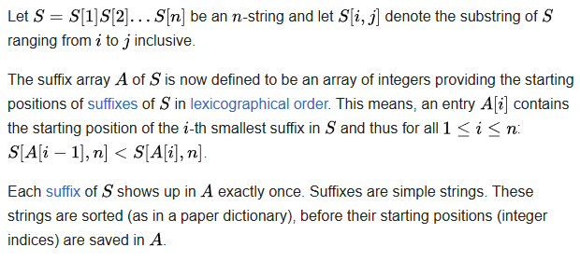
Data Structure: Suffix Array
Introduced by Manber & Myers (1990)
Cost to build: O(n² log n), cost to look up: O(m+log n), where m is the length of the query sequence and n is the length of the reference

Slide 4
Building a suffix array
Genome string TAGCAATG$
$ denotes the end of the string
Suffixes: 0 TAGCAATG$ 1 AGCAATG$ 2 GCAATG$ 3 CAATG$ 4 AATG$ 5 ATG$ 6 TG$ 7 G$ 8 $

Slide 5
Building a suffix array
Lexicographic order: $<A<C<G<T
Sort suffixes, record indices in an array: 8 $ 4 AATG$ 1 AGCAATG$ 5 ATG$ 3 CAATG$ 7 G$ 2 GCAATG$ 0 TAGCAATG$ 6 TG$
We cannot afford to store all these subsequences! Store just the indices!

Slide 6
Looking up in suffix array
Query sequence: GCAA
Binary search of the array, first look for strings starting with a G: Hi-> 8 $ 4 AATG$ 1 AGCAATG$ 5 ATG$ Starts with a G? -> 3 CAATG$ 7 G$ 2 GCAATG$ 0 TAGCAATG$ Lo-> 6 TG$

Slide 7
Looking up in suffix array
Query sequence: GCAA
When a match is found, go up and down to find all matching positions: 8 $ 4 AATG$ 1 AGCAATG$ 5 ATG$ Hi-> 3 CAATG$ 7 G$ Starts with a G? -> 2 GCAATG$ 0 TAGCAATG$ Lo-> 6 TG$

Slide 8
Looking up in suffix array
Query sequence: GCAA
When a match is found, go up and down to find all matching positions : 8 $ 4 AATG$ 1 AGCAATG$ 5 ATG$ 3 CAATG$ Hi -> Starts w GC? 7 G$ Lo -> Starts w GC? 2 GCAATG$ 0 TAGCAATG$ 6 TG$

Slide 9
Looking up in suffix array
Query sequence: GCAA
Found a perfect match: 8 $ 4 AATG$ 1 AGCAATG$ 5 ATG$ 3 CAATG$ 7 G$ Perfect match 2 GCAATG$ 0 TAGCAATG$ 6 TG$

Slide 10
Looking up in suffix array
Found a perfect match or unable to find longer match
When a match is found, go up and down to find all matching positions: 8 $ 4 AATG$ 1 AGCAATG$ 5 ATG$ 3 CAATG$ 7 G$ Perfect match 2 GCAATG$ 0 TAGCAATG$ 6 TG$

Slide 11
Perfect and imperfect matches
String match: TAGCAATG$ GCAA at position 2
What about imperfect matches , e.g. GCAT?

Slide 12
Looking up in suffix array
Query sequence: GCAT
Found a partial match – is it long enough to keep?: 8 $ 4 AATG$ 1 AGCAATG$ 5 ATG$ 3 CAATG$ 7 G$ Partial match 2 GCAATG$ 0 TAGCAATG$ 6 TG$

Slide 13
Example of alignment of two sequences
Start at the beginning of the query, find the longest match(es)
Indexed reference GCCCATGACTCGCATGCTGACATGCTGCTAGCT
Query TCGCATGCTTCATGGTGCTTGCTA

Slide 14
Alignment of two sequences
Start at the beginning of the query, find the longest match(es)
Indexed reference GCCCATGACTCGCATGCTGACATGCTGCTAGCT
TCGCATGCTTCATGGTGCTAGCTA

Slide 15
Alignment of two sequences
Start at the beginning of the query, find the longest match(es)
Indexed reference GCCCATGACTCGCATGCTGACATGCTGCTAGCT
TCGCATGCTTCATGGTGCTAGCTA

Slide 16
Alignment of two sequences
Use minimum matching length of 5 to avoid repetitive matches
Indexed reference GCCCATGACTCGCATGCTGACATGCTGCTAGCT
TCGCATGCTTCATGGTGCTAGCTA

Slide 17
Alignment of two sequences
Use minimum matching length of 5 to avoid repetitive matches
Indexed reference GCCCATGACTCGCATGCTGACATGCTGCTAGCT
TCGCATGCTTCATGGTGCTAGCTA

Slide 18
Alignment of two sequences
Do Smith-Waterman between the matching seeds
Indexed reference GCCCATGACTCGCATGCTGACATGCTGCTAGCT ||||||||| |||| |||||||| TCGCATGCTT-CATGGTGCTAGCTA
Compute alignment score based on Smith-Waterman alignment

Slide 19
Burrows-Wheeler Transform
Burrows-Wheeler Transform (BWT) is used to create efficient index of a sequence compared to just using the suffix array
BWT rearranges a character string into runs of similar characters, in a manner that can be reversed to recover the original string.
Used in bzip2 compression algorithm
Pairs with suffix array to create an efficient index into genome sequence

Slide 20
Burrows-Wheeler Transform
Example: BANANA$
All rotations: 0 BANANA$ 1 ANANA$B 2 NANA$BA 3 ANA$BAN 4 NA$BANA 5 A$BANAN 6 $BANANA
Sort in lexicographic order: 6 $BANANA 5 A$BANAN 3 ANA$BAN 1 ANANA$B 0 BANANA$ 4 NA$BANA 2 NANA$BA

Slide 21
Burrows-Wheeler Transform
Example: BANANA$
All rotations: 0 BANANA$ 1 ANANA$B 2 NANA$BA 3 ANA$BAN 4 NA$BANA 5 A$BANAN 6 $BANANA
Sort in lexicographic order: 6 $BANAN A 5 A$BANA N 3 ANA$BA N 1 ANANA$ B 0 BANANA $ 4 NA$BAN A 2 NANA$B A
Suffix Array:
6 5 3 1 0 4 2
BWT:
ANNB$AA

Slide 22
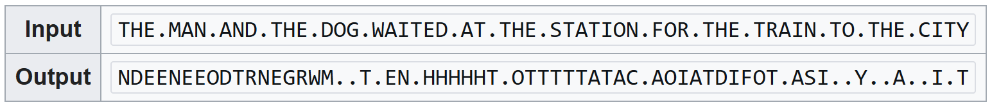
BWT rationale
If the original string had several substrings that occurred often, then the BWT-transformed string will have several places where a single character is repeated many times in a row, creating more-easily-compressible data.
Example:

Slide 23
BWT reversibility
A N N B $ A A
$A
A
A BN N
A$ NA
NA
BA $B AN AN
$B A$
AN
AN
BA NA NA
A$B NA$
NAN
BAN
$BA ANA ANA
$BA A$B
ANA
ANA
BAN NA$ NAN
A$BA NA$B
NANA
BANA
$BAN ANA$ ANAN
Sort
Add
Sort
Add
Sort
Add

Slide 24
BWT reversibility
A$BA NA$B
NANA
BANA
$BAN ANA$ ANAN
$BAN A$BA
ANA$
ANAN
BANA NA$B NANA
A$BAN NA$BA
NANA$
BANAN
$BANA ANA$B ANANA
$BANA
A$BAN
ANA$B
ANANA
BANAN NA$BA NANA$
A$BANA
NA$BAN
NANA$B
BANANA
$BANAN ANA$BA ANANA$
$BANAN
A$BANA
ANA$BA
ANANA$
BANANA NA$BAN NANA$B
Sort
Add
Sort
Add
Sort

Slide 25
BWT reversibility
A$BANAN
NA$BANA
NANA$BA
BANANA$
$BANANA ANA$BAN ANANA$B
$BANANA
A$BANAN
ANA$BAN
ANANA$B
BANANA$ NA$BANA NANA$BA
Add
Sort

Slide 26
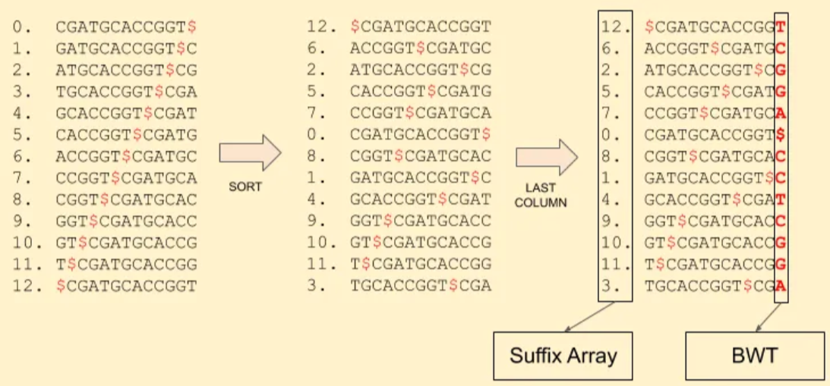
Using BWT and SA for sequence alignments
Reference sequence: CGATGCACCGGT:

Slide 27
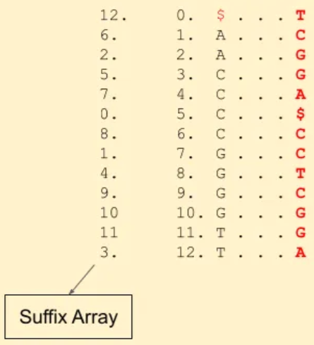
Using BWT and SA for sequence alignments
Reference sequence: CGATGCACCGGT,
Match read TGCA
Start at the end, look for A’s in the SA
Find which of the A’s are followed by C -- 1st C in the BWT, look at the 1st C in the SA

Slide 28
Using BWT and SA for sequence alignments
Reference sequence: CGATGCACCGGT,
Match read TGCA
Start at the end, look for A’s in the SA
Find which of the A’s are followed by C -- 1st C in the BWT, look at the 1st C in the SA
Is that C followed by a G -- yes, 2nd G in the BWT

Slide 29
Using BWT and SA for sequence alignments
Reference sequence: CGATGCACCGGT,
Match read TGCA
Start at the end, look for A’s in the SA
Find which of the A’s are followed by C -- 1st C in the BWT, look at the 1st C in the SA
Is that C followed by a G -- yes, 2nd G in the BWT
Is the G followed by a T -- yes, 2nd T in the BWT

Slide 30
Using BWT and SA for sequence alignments
Reference sequence: CGATGCACCGGT,
Match read TGCA
Start at the end, look for A’s in the SA
Find which of the A’s are followed by C -- 1st C in the BWT, look at the 1st C in the SA
Is that C followed by a G -- yes, 2nd G in the BWT
Is the G followed by a T -- yes, 2nd T in the BWT

Slide 31
Using BWT and SA for sequence alignments
Reference sequence: CGATGCACCGGT,
Match read TGCA
Start at the end, look for A’s in the SA
Find which of the A’s are followed by C -- 1st C in the BWT, look at the 1st C in the SA
Is that C followed by a G -- yes, 2nd G in the BWT
Is the G followed by a T -- yes, 2nd T in the BWT
The SA index of that T is 3!

